Slide 1
Validation

Slide 2
3 types of trigger
https://wpf-tutorial.com/vi/93/styles/trigger-datatrigger-eventtrigger/

Slide 3
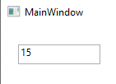
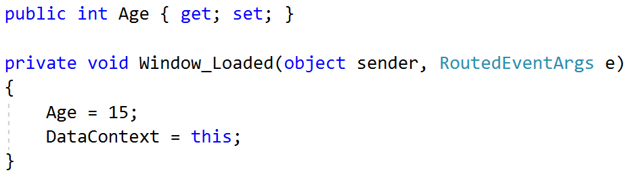
Starting example
<Canvas Name="contentCanvas">
<TextBox Name="ageTextBox" Text="{Binding Age}"
Width="100" Height="24"
Canvas.Left="21" Canvas.Top="24">
</TextBox>
</Canvas>

Slide 4
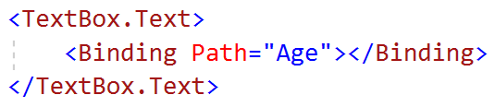
Another way of writing binding
<Canvas Name="contentCanvas">
<TextBox Name="ageTextBox"
Text="{Binding Age}"
Width="100" Height="24"
Canvas.Left="21" Canvas.Top="24">
</TextBox>
</Canvas>

Slide 5
Update source trigger
LostFocus
PropertyChanged
INotifyPropertyChanged

Slide 6
Rule
What if we want age to be in the range of 20-45?
Let’s define a rule

Slide 7
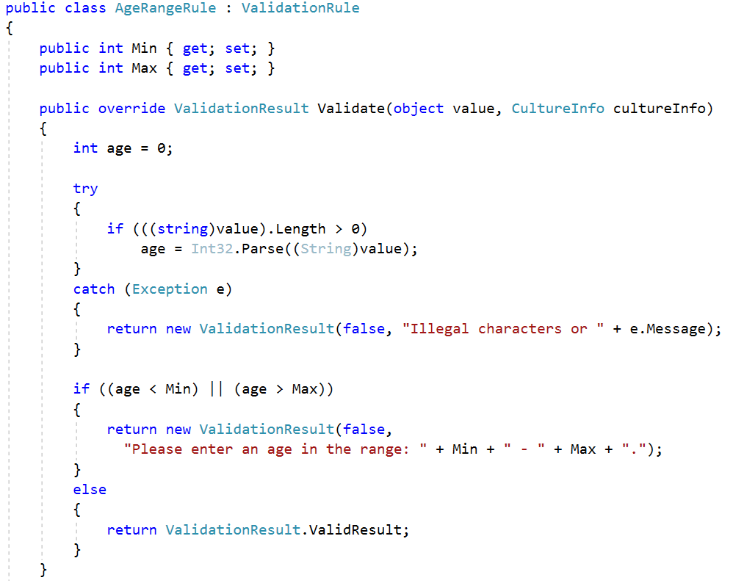
Age Range rule

Slide 8
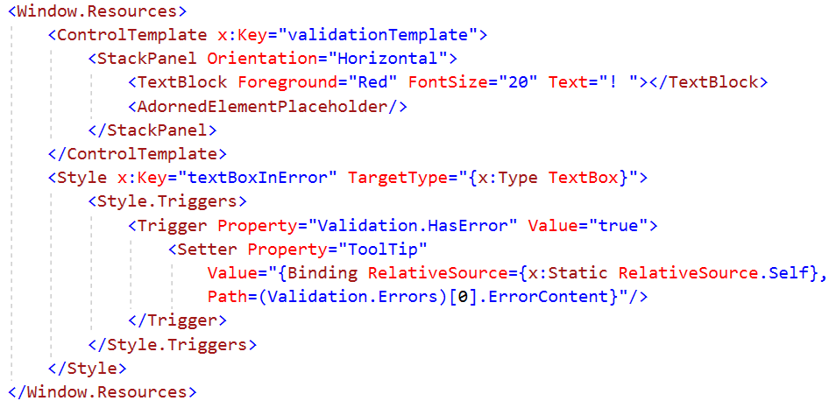

Prepare resources
AdornedElementPlaceHolder: has exactly the same size of the UIElement you’re validating.
Notes:
<Window.Resources>
<ControlTemplate x:Key="validationTemplate">
<StackPanel Orientation="Horizontal">
<TextBlock Foreground="Red" FontSize="20" Text="! "></TextBlock>
<AdornedElementPlaceholder/>
</StackPanel>
</ControlTemplate>
<Style x:Key="textBoxInError" TargetType="{x:Type TextBox}">
<Style.Triggers>
<Trigger Property="Validation.HasError" Value="true">
<Setter Property="ToolTip"
Value="{Binding RelativeSource={x:Static RelativeSource.Self},
Path=(Validation.Errors)[0].ErrorContent}"/>
</Trigger>
</Style.Triggers>
</Style>
</Window.Resources>

Slide 9
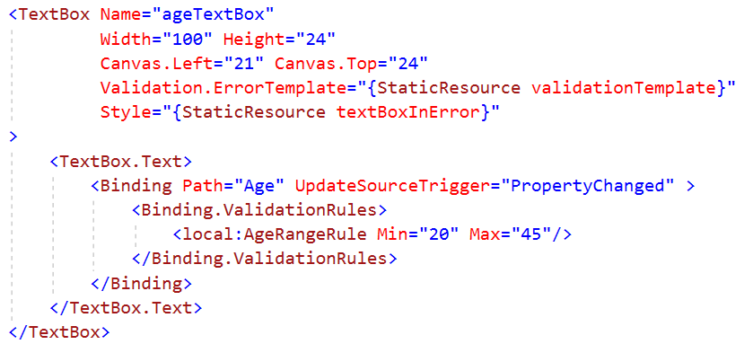
Add to binding rule

Slide 10
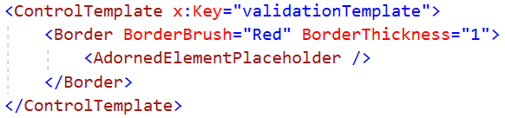

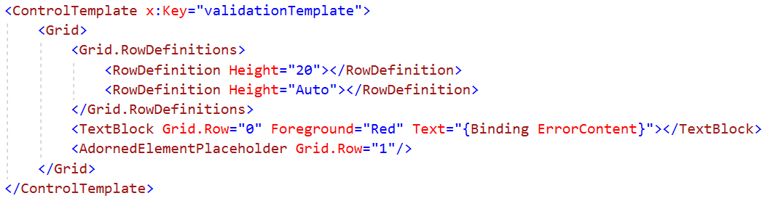
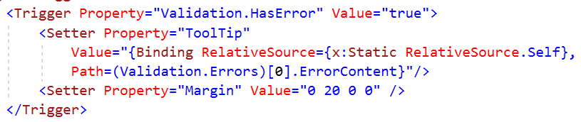

Other types of error

